Slide 1
Strategies to improve the impact of EMTCT programs and reduce HIV incidence during pregnancy and the post-partum period
The Last Mile to EMTCT: Are we there yet?
Dr. Heather Watts
Office of the Global AIDS Coordinator
Director for HIV Prevention and Community
PEPFAR

Slide 2
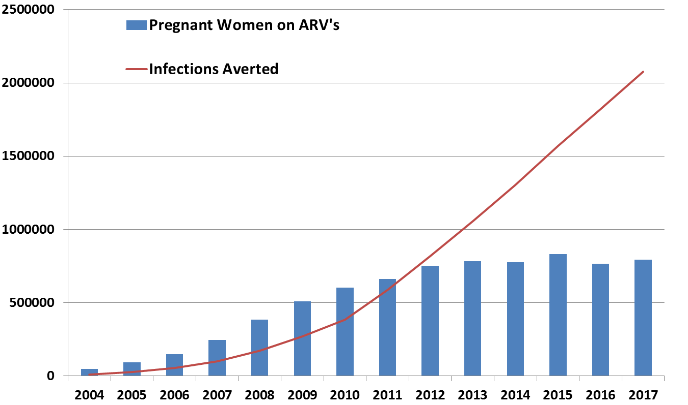
What is PEPFAR doing now towards EMTCT?
Over 2.2 million infant HIV infections have been averted with PEPFAR support globally, but declines have leveled out recently; missing
women who don’t come for ANC, and
women who seroconvert during the pregnancy and breastfeeding.
We are pushing into the ‘Last Mile’ space of PMTCT programmatic gaps, making it more costly and challenging to reach remaining women and children with:
antenatal services
HIV testing
use of ART for life
safe childbirth practices
appropriate breastfeeding
infant testing and
other post natal care services
As such we are continuing to scale up innovative options for primary prevention activities integrated within, and complementary to, all services we provide for women of reproductive age regardless of HIV status.

Slide 3
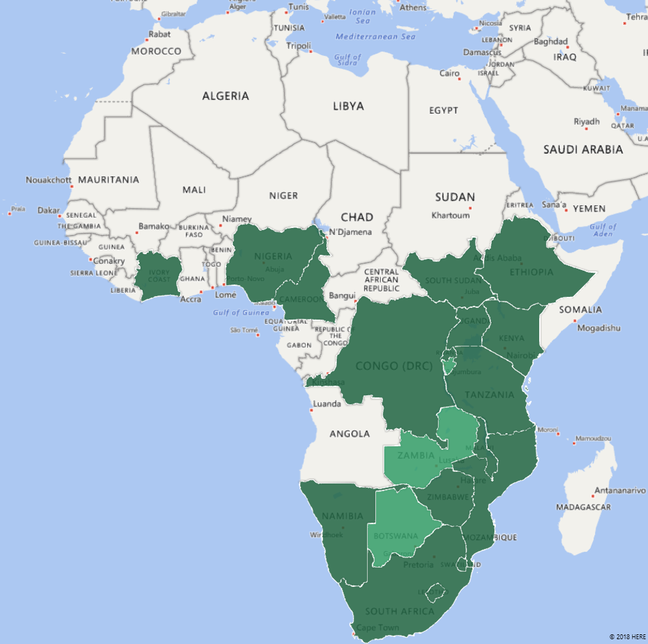
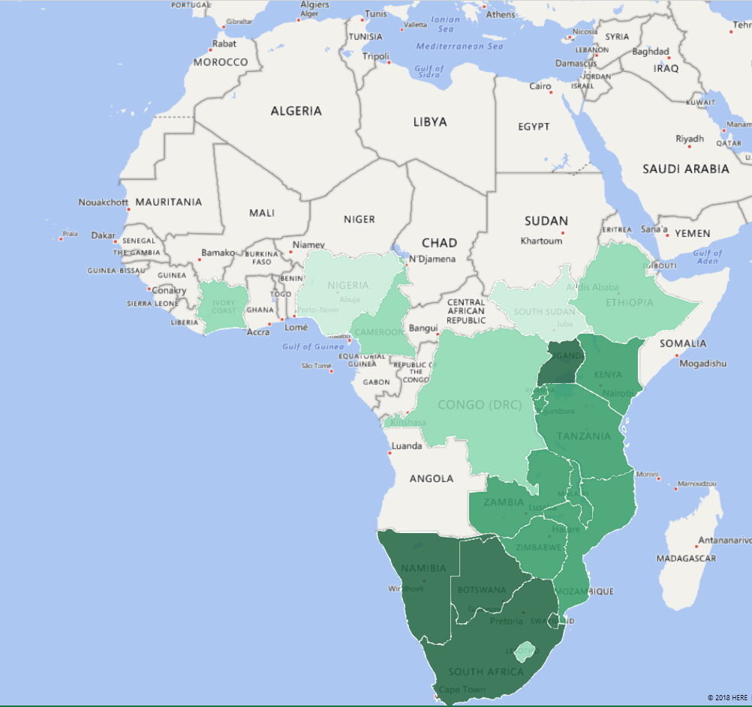
ART coverage among HIV-positive pregnant women in PEPFAR-supported countries
High coverage of testing and ART for those attending ANC, but gaps in ANC1
PEPFAR APR17
UNAIDS estimates, 2016
Source: http://aidsinfo.unaids.org/
Notes:
One of the key process indicators for eligibility for the Path to Elimination and EMTCT is ART coverage of at least 90% among HIV-positive pregnant women (for silver and bronze tiers) and 95% for gold tier and EMTCT.
Countries with PEPFAR-supported PMTCT programs are highlighted in various shades of green on these maps.
The map on the left shows that ART coverage among women enrolled in ANC at PEPFAR-supported health facilities is very high – with all countries over 90% ART coverage, and all but 3 countries >95% ART coverage.
However, national estimates for ART coverage among HIV-positive pregnant women, shown in the map on the right, are much lower – this is principally due to low ANC attendance in countries, and could also reflect differences in ART coverage at PEPFAR-supported sites vs. all sites nationally. You can see that in West African countries, Ethiopia, Congo and South Sudan, ART coverage nationally is estimated at <75%, even though facility based coverage at PEPFAR sites is >95%.
This reflects some of the work that is required for EMTCT validation – stepping back and looking at EMTCT from a national level by assessing the available data sources, identifying gaps in the PMTCT program, lab services, and data systems, and using targeted strategies to move toward elimination. Clearly all of this work, especially reducing ANC access barriers in general, is not the sole responsibility of PEPFAR, however PEPFAR and CDC should contribute to development of a national EMTCT strategy that takes all of these issues into account.
In terms of the impact indicators of MTCT rate and case rate, these are more complex to measure – in MER data, the data quality of the PMTCT_FO indicator is poor for most countries, so developing or strengthening PMTCT cohort monitoring systems and tracking infant outcomes will be key to successful validation of EMTCT.

Slide 4
PEPFAR Strategies to Support eMTCT
Primary Prevention
HIV prevention for AGYW through DREAMS and for high risk pregnant/BF women, especially AGYW, PrEP
HIV Testing
Re-testing of women during pregnancy and postpartum to improve early identification of incident infections and provide ART
Increased male partner HIV testing including HIV self-testing to identify discordant couples
Pregnancy and Post Partum
More systematic and frequent VL monitoring throughout pregnancy/BF with rapid intervention for viral failure
Enhanced interventions for HIV-exposed infants, including tracking/retention of mother-infant pairs, POC EID to shorten results and allow earlier ART
Advocacy
Path to elimination as a way to advocate for continued focus on PMTCT
Start Free, Stay Free, AIDS Free

Slide 5
Closing the EMTCT Gaps
Treat All
HIV prevention/
PrEP/Retesting
RETAIN
TREAT
TEST
INFANT TESTING & CARE
Pregnant Women without HIV
TEST ♀
TREAT ♀
VL
RETAIN ♀
Healthy Mom, Baby & Family
Women living with HIV
Pregnant Women living with HIV
Cross-cutting issues:
Vulnerable populations
Patient-centered care
Reducing stigma and discrimination
M&E
Supply Chain
Training
Safe conception
Slide adapted from Shaffiq Essajee, WHO

Slide 6
Strategies to reach EMTCT: HIV prevention
Challenge: High maternal HIV prevalence
Strategies: DREAMS-like HIV prevention programs for AGYW (pregnant and non-pregnant) PrEP for women at high risk of HIV acquisition Improve case finding, ART coverage and viral suppression among male partners
HIV Prevalence | MTCT rate | Case Rate
1% | 5% | 50/100,000
2% | 2.5% | 50/100,000
5% | 1% | 50/100,000
10% | 0.5% | 50/100,000
20% | 0.25% | 50/100,000
What would it take to reach EMTCT?
Notes:
From the table at the bottom of the slide, the MTCT rate required to reach the EMTCT case rate varies widely based on HIV prevalence, such that a country with 20% prevalence will have great difficulty reaching EMTCT; whereas a country with 1% prevalence can reach elimination with an MTCT rate of 5%.
For most countries, focusing on prevention in AGYW is a key element in reaching EMTCT.

Slide 7
Prong 1: Preventing HIV Infection in Women

Slide 8
DREAMS – A Movement
For the first time, the latest PEPFAR data show significant declines in new HIV diagnoses among adolescent girls and young women. In the 10 African countries (63 districts) implementing DREAMS, the majority (65%) of the highest-HIV-burden communities or districts achieved a 25-40 percent or greater decline in new HIV diagnoses among young women. ‎Importantly, new diagnoses declined in nearly all DREAMS intervention districts.

Slide 9
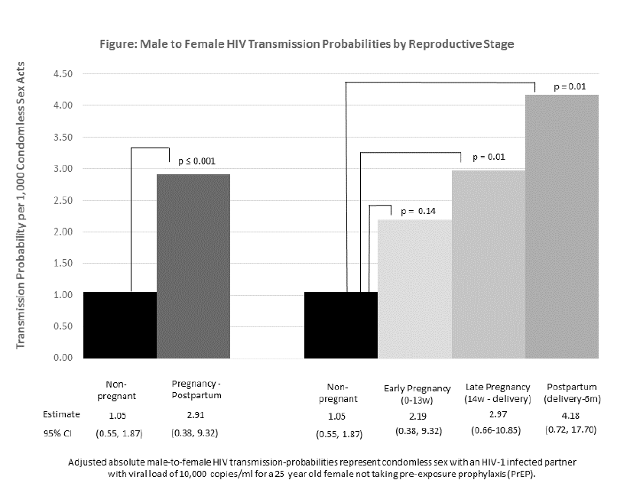
Female HIV Acquisition Per Sex Act is Elevated in Late Pregnancy and Postpartum
2,751 African HIV serodiscordant couples with HIV uninfected female partners followed prospectively
HIV transmission probability per 1,000 sex acts
1.05 when not pregnant
2.19 in early pregnancy
2.97 in late pregnancy
4.18 in postpartum women
After adjustment for condom use, age, use of PrEP, and HIV viral load, the probability of HIV transmission per sex act compared to non-pregnant time was significantly higher:
late pregnancy aRR 2.82, p=0.01
postpartum aRR 3.97, p=0.01
These findings emphasize the importance of partner testing and offering PrEP in the antenatal and postpartum care settings for women at high risk of HIV acquisition.
Source: CROI Abstract, 2018
Notes:
(Slide is from:
45 FEMALE HIV ACQUISITION PER SEX ACT IS ELEVATED IN LATE PREGNANCY AND POSTPARTUM
Kerry A. Thomson1, James P. Hughes1, Jared Baeten1, Grace John-Stewart1, Connie L. Celum1, Craig R. Cohen2, Nelly R. Mugo1, James Kiarie1, Renee Heffron1
1University of Washington, Seattle, WA, USA, 2University of California San Francisco, San Francisco, CA, USA
Background: In many settings with high HIV prevalence, fertility rates are also high and women spend a significant proportion of their reproductive years pregnant, postpartum, or breastfeeding. Some, but not all, studies have demonstrated significantly higher HIV incidence during pregnancy. Per sex act analyses contribute an understanding of the absolute and relative risks of HIV transmission, and can provide insight into whether increased risk during pregnancy and postpartum is attributable to biological or sexual behavior changes. These data are critical to inform the delivery of HIV prevention interventions for women.
Methods: 2,751 African HIV serodiscordant couples with HIV uninfected female partners were followed prospectively for ≤48 months in two HIV prevention studies. Sexual frequency and condom use was reported monthly. HIV and pregnancy testing occurred monthly or quarterly depending on the study. Study time was categorized by reproductive stage as early pregnancy, late pregnancy, up to 6 months postpartum, or non-pregnant. HIV events that could not be linked between study partners by genetic sequencing were excluded. We used a complementary log-log model to compare the probability of male-to-female HIV transmission per sex act by reproductive stage. The reference case for HIV transmission probability is a condomless sex act between a 25 year old woman not using PrEP and a male partner with HIV RNA of 10,000 copies/ml.
Results: Pregnancy incidence was 12.50 per 100 woman-years (95% CI: 11.52-13.55) and 82 HIV transmission events occurred. The HIV transmission probability was 1.05 per 1,000 sex acts when women were not pregnant, 2.19 in early pregnancy, 2.97 in late pregnancy, and 4.18 in postpartum women (Figure). After adjustment for condom use, age, use of PrEP, and HIV viral load, the probability of HIV transmission per sex act was significantly higher in late pregnancy (aRR 2.82, p=0.01) and postpartum (aRR 3.97, p=0.01) compared to non-pregnant time.
Conclusion: The risk of HIV transmission per sex act steadily increased through pregnancy and was highest during postpartum, even after accounting for sexual behavior, PrEP, and HIV viral load, suggesting that biological changes during these periods increase HIV risk. While further research is needed to better understand biological susceptibility, scale-up of HIV prevention and testing in antenatal and postpartum care in high HIV prevalence settings is warranted to prevent sexual transmission and identify acute maternal HIV infections.

Slide 10
Data-Informed Approaches To Reach Men and Boys
Reach more boys and men with HIV testing services |  | Index case testing Male testing, family testing days Voluntary Assisted PN VMMC and linkage to other services Self-testing
Create Male Friendly Services |  | Extended hours Male friendly clinics and support (e.g., male clinicians; male only hours on weekends) Youth friendly health services
Improve access through community engagement programs |  | Targeted community testing and care: hotspots & moonlight testing, workplace programs, DMOC Community wellness program (integrated package including mobile testing)
Comprehensive programming to change attitudes and behavior |  | Programming for sexual violence prevention, such as Families Matter Targeted gender/age risk reduction and risk-based testing
Notes:
Demand creation and community sensitization activities are conducted prior to outreach HIV testing and messages target men.
Models of outreach testing include hotspot and workplace testing using mobile teams of health workers who provide HIV testing. Work places were visited in coordination with HTS focal persons within the institutions. Health talks were conducted by a dedicated cadre of HIV testers- HIV diagnostic assistants (HDAs) or ART providers. Demand creation activities also included joint drama performances by employees in collaboration with the Malawi AIDS Counselling and Resource Center (MACRO), an implementing partner who was subcontracted by MSH. MACRO is a well-recognized indigenous organization which has been providing HIV services for over a decade in Blantyre. Those clients who are identified as positive are then actively linked to an ART clinic.

Slide 11
HIVST Evidence: Secondary Distribution to Partners: Partners of ANC and FSWs
INTERVENTION
HIV-negative women aged 18–39y at two sites in Kisumu, Kenya
ANC facility and FSW drop-in centre;
ANC received three self-tests; drop-in centre received five self-tests.
Outcomes included the # self-tests distributed, proportion of sexual partners used a self-test, couples testing, and sexual behaviour after self-testing.
Lancet, 2016
RESULTS
High acceptability! very or somewhat positive perception (>90%) and very or somewhat ease of use (>80%) by partners receiving HIVST
High uptake! 53 of 58 participants in antenatal care, 91 of 106 in post-partum care, and 64 of 85 female sex workers. 82 (81%) of 101 female sex workers distributed more than one self-test to commercial sex clients.
Increased couples testing and case identification: in 51% (n=27) in ANC, 68% (n=62) from post-partum care, and 83% (n=53) FSWs. Among tests received by primary and non-primary sexual partners, yields: 4% ANC partners, 2% PPC partners, and 14% FSW partner/clients had positive results.
Increased reported condom use with pos partners: Participants reported sexual intercourse with eight (18%) of 45 who tested HIV-positive; condoms were used in all eight intercourse events after positive results compared with 104 (44%) after of negative results (p<0·0018).
Four participants reported intimate partner violence as a result of self-test distribution: two in the post-partum care
group and two female sex workers. No other adverse events were reported.
Notes:
31 countries with supportive policy & increase in implementation
China - point out that it is widely available and used according to reports - particularly among MSM
anecdotal

Slide 12
PrEP Programming Priorities for FY2019: Accelerating PrEP Rollout & Implementation
PEPFAR is focusing on accelerating oral PrEP rollout and implementation for key populations and other populations at substantial risk of HIV infection, including adolescent girls and young women and serodiscordant couples.
PrEP is being included as a part of a package of comprehensive prevention services that includes risk-reduction counseling, condom and lubricant promotion, VMMC, and structural interventions to reduce vulnerability to HIV infection.
PREP_NEW Targets FY2017-FY2019
47% Increase
FY2019**
305% Increase
FY2018*
FY2017
FY2017
All results and targets: PREP_NEW, N, DSD + TA
*Targets for Cote d'Ivoire and Mozambique removed because of data error, countries did not set targets for FY2018.
**FY2019 targets for Asia Regional Program and any other PEPFAR STAR countries are not included in this total.

Slide 13
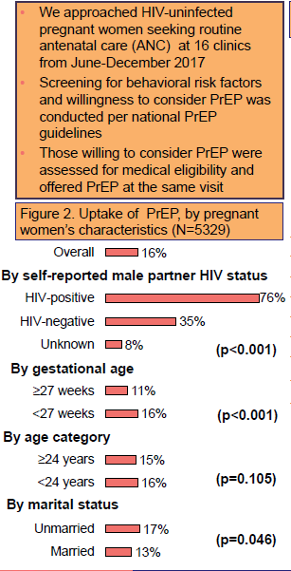
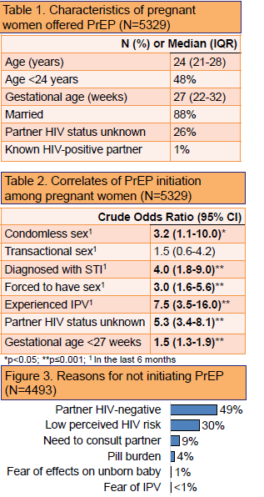
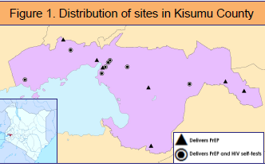
1047 High PrEP Uptake Among Kenyan Pregnant Women Offered PrEP during Antenatal Care
Overall, 16% of high risk pregnant women accepted PrEP. The most common reasons for declining were known HIV-negative partner and low perceived risk.
Very few women declined because of concerns about safety of the PrEP drugs.

Slide 14
PRONG 3: Maximizing Prevention of MTCT for Women Living with HIV

Slide 15
We are finding as many pregnant women as ever with more focused testing

Slide 16
More pregnant women are receiving ART and entering pregnancy on ART.

Slide 17
Strategies to reach EMTCT: PMTCT programming
Challenge: High proportion of HIV-positive pregnant/breastfeeding women not receiving PMTCT services
Reasons: | Strategies:
Low ANC/maternal ART coverage | Reduce access barriers (distance, user fees) Community engagement (e.g. community and religious institutions/leaders, TBAs, male engagement)
Poor identification of incident HIV infections in PBFW | Re-testing in third trimester, L&D, postpartum Maternal HIV testing in immunization clinics Enhanced postnatal prophylaxis for high-risk infants
Notes:
I won’t go into details on the strategies now – and our presenters will speak to some of these - but I wanted to highlight the overall approach of identifying the country’s greatest challenges through data review and then prioritizing the appropriate program strategies.

Slide 18
Challenge: High MTCT rates among women receiving PMTCT services
Reasons: | Strategies:
Poor ART adherence/ high VL | ART adherence support (e.g. peer mentors, text reminders) Frequent VL monitoring in PBFW and expedited assessment for treatment failure in women with high VL Enhanced postnatal prophylaxis for high-risk infants
High LTFU in PMTCT care | Peer support/ mentor mothers Active patient tracking for missed appointments DSD models
Strategies to reach EMTCT: PMTCT programming
Challenge: High MTCT rates among women receiving PMTCT services
Reasons: | Strategies:
Poor ART adherence/ high VL | ART adherence support (e.g. peer mentors, text reminders) Frequent VL monitoring in PBFW and expedited assessment for treatment failure in women with high VL Enhanced postnatal prophylaxis for high-risk infants
High LTFU in PMTCT care | Peer support/ mentor mothers Active patient tracking for missed appointments DSD models

Slide 19
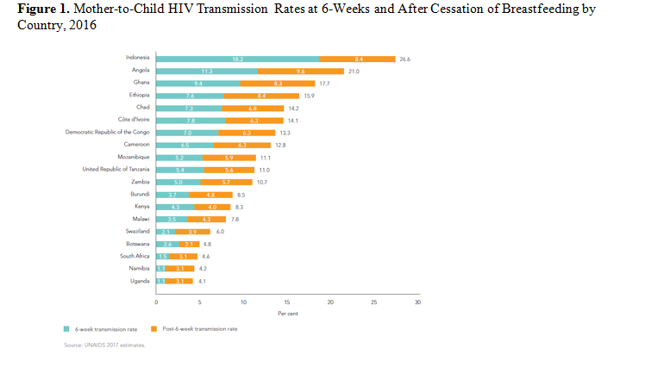
Over half of transmissions occur during breastfeeding. Must assure viral suppression.
UNAIDS

Slide 21
PEPFAR Strategies to Support eMTCT
Primary Prevention
HIV prevention for AGYW through DREAMS and for high risk pregnant/BF women, especially AGYW, PrEP
HIV Testing
Re-testing of women during pregnancy and postpartum to improve early identification of incident infections and provide ART
Increased male partner HIV testing including HIV self-testing to identify discordant couples
Pregnancy and Post Partum
More systematic and frequent VL monitoring throughout pregnancy/BF with rapid intervention for viral failure
Enhanced interventions for HIV-exposed infants, including tracking/retention of mother-infant pairs, POC EID to shorten results and allow earlier ART
Advocacy
Path to elimination as a way to advocate for continued focus on PMTCT
Start Free, Stay Free, AIDS Free

Slide 22
15 Year Anniversary of PEPFAR’s Enactment
Nelly lived in fear of stigma for 10 years until she connected with a PEPFAR supported clinic in 2005. Now, she is one of over 14 million people receiving lifesaving treatment with PEPFAR support and has a healthy baby, Charity – one of the over 2.2 million babies born HIV-free thanks to PEPFAR’s assistance - who wants to be a doctor when she grows up.

Slide 23
Thank You!

